Slide 1


Usage Funnels
Analyze Data with SQL
Mariia Rozum
Date 02.02.2022

Slide 2
Goals of project
Analyze different Warby Parker’s marketing funnels in order to calculate conversion rates.
Calculate drop off rate on each rent step of marketing funnels.
Calculate the difference in purchase rates between customers who had 3 numbers of pairs tried with ones who had 5.
The most common results of the style according to quiz and type of purchase made.

Slide 3
1. Drop off rate
in start-up’s survey.

Slide 4
1.1 Quiz table
To help users find their perfect frame, Warby Parker has a Style Quiz. Users will “give up” at different points in the survey. Let’s analyze how many users move from Question 1 to Question 2, etc. We have created a quiz funnel using the GROUP BY command. The ‘Compare conversion’ column has the percentage of users who answer each question.
No. 3 and 5 question(s) of the quiz have a lower completion rates. It seems to me that these questions may be too hard to answer immediately.
We need to move question 4 to be on the third place (so more people will complete this question before a drop off) and work on simplicity of the last two questions. In ‘Overall conversion rates’ column we can see that only 54% completed the survey.
Quiz question | Number of answers | Compare conversion | Overall conversion rates
1. What are you looking for? | 500 | 1 | 1
2. What's your fit? | 475 | 0.95 | 0.95
3. Which shapes do you like? | 380 | 0.8 | 0.76
4. Which colors do you like? | 361 | 0.95 | 0.722
5. When was your last eye exam? | 270 | 0.75 | 0.54

Slide 5
2. Warby Parker’s marketing funnels

Slide 6
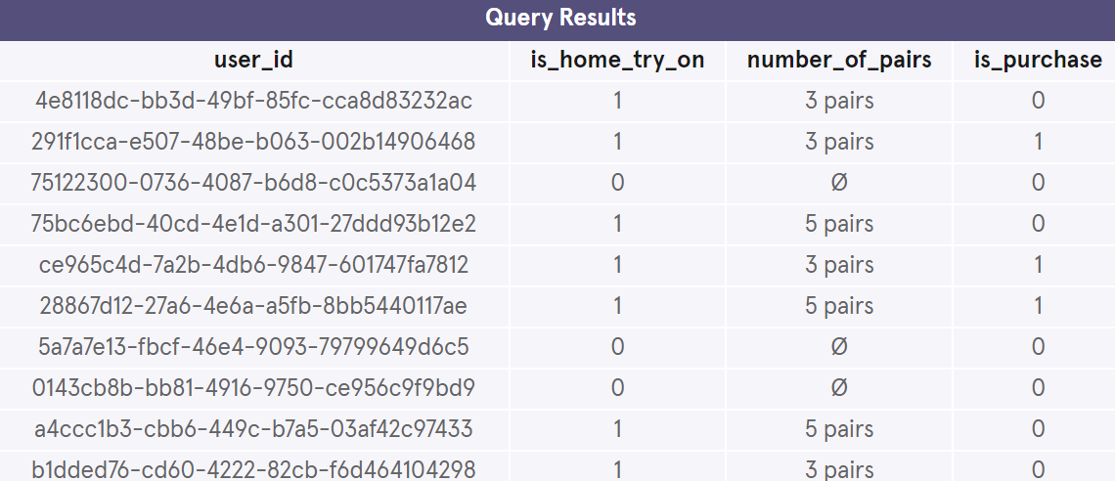
2.1 Funnel
Home Try-On Funnel:
Take the Style Quiz → Home Try-On → Purchase the Perfect Pair of Glasses
(quiz, home_try_on, purchase tables accordingly)
#I have used a LEFT JOIN to combine the three tables, starting with the top of the funnel (quiz) and ending with the bottom of the funnel (purchase).
SELECT DISTINCT quiz.user_id,
home_try_on.user_id IS NOT NULL AS 'is_home_try_on',
home_try_on.number_of_pairs,
purchase.user_id IS NOT NULL AS 'is_purchase'
FROM quiz
LEFT JOIN home_try_on
ON quiz.user_id = home_try_on.user_id
LEFT JOIN purchase
ON purchase.user_id = quiz.user_id
LIMIT 10;
column1 | column2 | column3

Slide 7
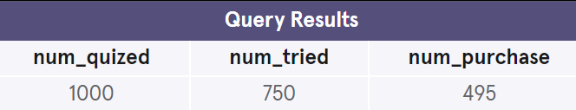
2.2 Conversion rates
We can compare conversion:
quiz→home_try_on which is 75%
and home_try_on→purchase is 66%
It is good conversion rate, three quatres people are interested to try on glasses, but 44% still do not purchase after trying on.
Let’s compare how many pairs of glasses did they receive – 3 or 5?
#WITH clause to use new funnel table
WITH funnels AS (SELECT DISTINCT quiz.user_id,
home_try_on.user_id IS NOT NULL AS 'is_home_try_on',
home_try_on.number_of_pairs,
purchase.user_id IS NOT NULL AS 'is_purchase'
FROM quiz
LEFT JOIN home_try_on
ON quiz.user_id = home_try_on.user_id
LEFT JOIN purchase
ON purchase.user_id = quiz.user_id)
SELECT COUNT(*) AS 'num_quized',
SUM(is_home_try_on) AS 'num_tried',
SUM(is_purchase) AS 'num_purchase'
FROM funnels;
column1 | column2 | column3
100% | 75% | 66%

Slide 8
3. A/B test results:

Slide 9
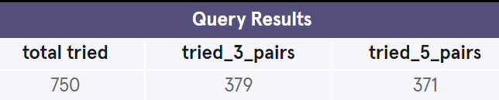
3.1 A/B test
# 1 if they tried at home and 0 if not
WITH funnels AS (SELECT DISTINCT quiz.user_id,
home_try_on.user_id IS NOT NULL AS 'is_home_try_on',
home_try_on.number_of_pairs,
purchase.user_id IS NOT NULL AS 'is_purchase'
FROM quiz
LEFT JOIN home_try_on
ON quiz.user_id = home_try_on.user_id
LEFT JOIN purchase
ON purchase.user_id = quiz.user_id)
SELECT SUM(is_home_try_on) AS 'total tried',
SUM(CASE
WHEN number_of_pairs = '3 pairs'
THEN is_home_try_on
END) AS 'tried_3_pairs',
SUM(CASE
WHEN number_of_pairs = '5 pairs'
THEN is_home_try_on
END) AS 'tried_5_pairs'
FROM funnels;
During the Home Try-On stage, we will be conducting an A/B Test:
50% of the users will get 3 pairs to try on
50% of the users will get 5 pairs to try on
column1 | column2 | column3
100% | 50.5% | 49.5%

Slide 10
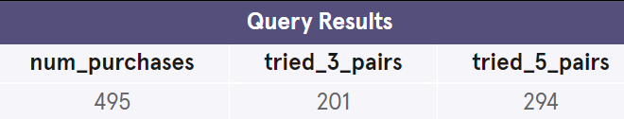
3.2 A/B test conversion rates
66% of customers, who received 3 or 5 pairs of glasses have made a purchase.
Almost 60% of these customers have received 5 pairs to try at home.
It can mean that the more styles customer tries the more likely they will make a purchase.
Purchase rate for 3 pairs: 53% (201/379)
Purchase rate for 5 pairs: 79% (294/371)
It is recommended to encourage customers to try 5 pairs of glasses at home.
WITH funnels AS (SELECT DISTINCT quiz.user_id,
home_try_on.user_id IS NOT NULL AS 'is_home_try_on',
home_try_on.number_of_pairs,
purchase.user_id IS NOT NULL AS 'is_purchase'
FROM quiz
LEFT JOIN home_try_on
ON quiz.user_id = home_try_on.user_id
LEFT JOIN purchase
ON purchase.user_id = quiz.user_id)
SELECT SUM(is_purchase) AS 'num_purchases',
SUM(CASE
WHEN number_of_pairs = '3 pairs'
THEN is_purchase
END) AS 'tried_3_pairs',
SUM(CASE
WHEN number_of_pairs = '5 pairs'
THEN is_purchase
END) AS 'tried_5_pairs'
FROM funnels;
column1 | column2 | column3
100% | 40.6% | 59.4%

Slide 11
4. The most common style

Slide 12
4.1 Common style of glasses
QUIZED
style | COUNT
Women's Styles | 469
Men's Styles | 432
I'm not sure. Let's skip it. | 99
PURCHASED
style | COUNT
Women's Styles | 252
Men's Styles | 243
The most common results of the style quiz.
According to the quiz, only 9.9% of customers are not sure about style.
The distribution between Women’s and Men’s Styles is almost equal.
The most common types of purchase made.
In the purchase table the distribution between Women’s and Men’s Styles are roughly 50%-50%.
It means, that there is no favored style, or that male and female customers are represented equally in this online shop.
We can make two conclusions:
Start-up should focuse on both styles equally.
They can trust their questionary, the answers are similar to the real purchase.

